Slide 1
The Business education leadership project
Denise Gregor, Coordinator
dgregor@placercoe.k12.ca.us
Notes:
Welcome to the Business Education Leadership Project Workshop
Today, I hope to explain to you who I am, what the project is about, get your help in generating ideas for our first workgroup, provide an example of a student success and answer any questions you might have.
There’s a clipboard going around that I am asking you to sign in.

Slide 2







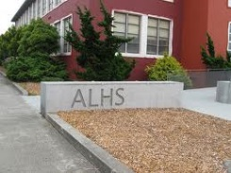
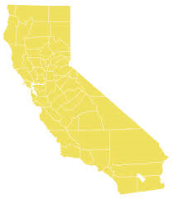


Who am I?
Notes:
Picture of me teaching

Slide 3


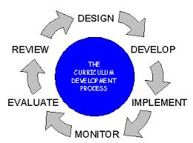


What is CA BELP?
A statewide project administered by the Placer County Office of Education
Funded by CDE & Perkins
Notes:
Too much, pictures to illustrate

Slide 4

Times They are a Changing
Notes:
9:40
Challenges are plentiful:
1.LLCFF (locally controlled funding formula)
2.Pressure to acquire A-G approval for all courses
3.Common Core
4.CTE Model Curriculum Standards -Teams of professional representatives from business and industry, postsecondary, secondary, CTE, academic, county, state and local education leaders reviewed and revised CTE standards.
•All 15 Industry sectors are still intact but there are a few title changes.
Opportunities:
1.California Pathways Trust Grant -$250 million, one time grant to create innovative programs and partnerships linking rigorous academic standards to career pathways in high-need and high-growth sectors of the economy. K-12 and community colleges.
2. Up the anti – better our practices
Sing our Praises – Let others know the great things happening in college and career readiness through CTE
Lots of State and National Chatter surrounding college and career readiness and CTE
According to a national report, students enrolled in CTE graduate at a rate of 90.8% nationally compared to the average of 74.9%.
CSUs report that the largest undergraduate degree program currently is business
Industry Sector Pathway Standards
▪Content specific to pathway expectations
•CCSS Matrix
▪Identifies MCS standards that align w/CCSS
Unique to industry sector
•Organized by careers within the industry sector of similar work environments
•Describes what students should know and be able to do once the standard is achieved
•Build from simple to complex knowledge and performance

Slide 5


Where we’ve been
  New Model Standards
  Online platforms (CTEonline, Leading Edge Certification)
  Curriculum Development and Dissemination
Notes:
1097 approved with 29 accepted as a C (math), 11 as a B (English), and 6 as an A (history/social science), 1051 as a G (elective)
California Partnership academies and NAF (National Academy Foundation) academies have been granted program status.
The new model curriculum standards were rolled out. The standards include 11 anchor standards, an academic alignment matrix, and pathway standards.
Business & Finance has three pathways: Business Management, Financial Services, and International Business
The Marketing, Sales and Service pathways include: Marketing, Entrepreneurship/Self Employment, and Professional Sales.
Sheryl led several groups to create lessons online utilizing CTEonline, and providing an opportunity for Leading Edge Certification (online teaching)
Several teacher workgroups produced some great curriculum, including a new Business Leadership course

Slide 6
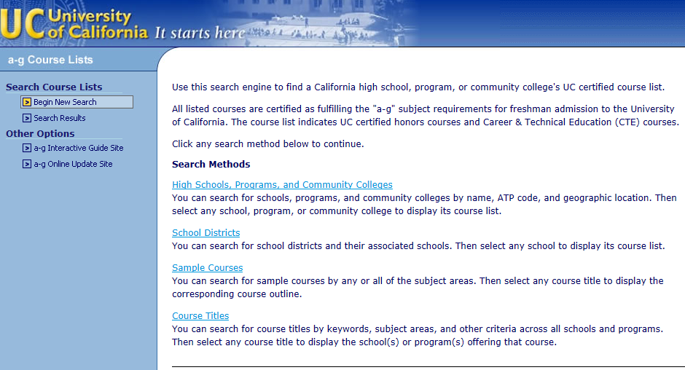
Four search methods available for courses already submitted and approved.
www.ucop.edu/doorways
Notes:
UC Doorways screen shot, you can search by four methods to see if there are any courses comparable to your own.

Slide 7
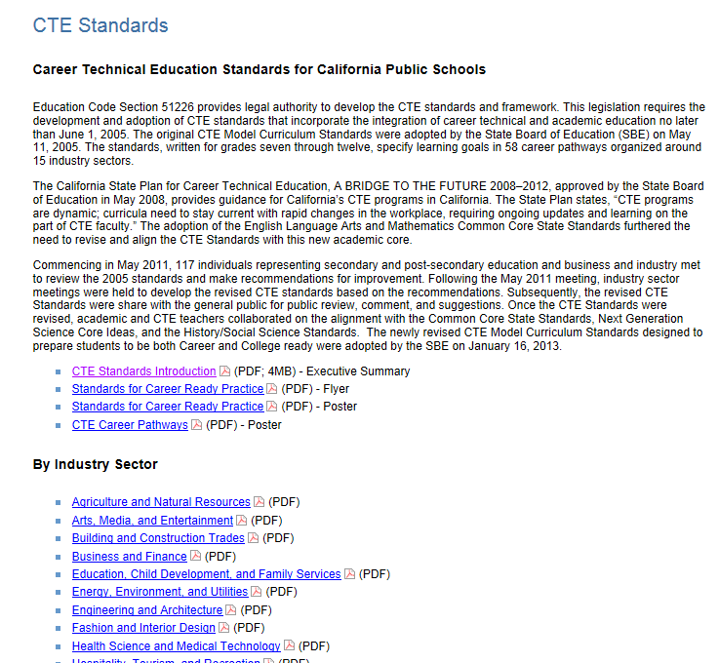
www.cde.ca.gov
CTE Model Curriculum Standards
Notes:
Model standards are in a pdf format; for all sectors of industry.

Slide 8
PATHWAY STANDARDS
2005 Standards |  | 2103 Standards
A. E-commerce Pathway |  | A. Marketing Pathway
A1.0 Students understand the fundamental concepts of e-commerce: |  | A1.0 Demonstrate an understanding of business fundamentals, uses and application of technologies, communications, and basic management functions.
A1.1 Explain how e-commerce is similar to and different from traditional commerce, including comparing the competitive environment of online models with traditional business models. |  | A1.1 Describe current business and marketing trends.
A1.2 Understand the economic impact of the partnership between the Internet and business. |  | A1.2 Describe tools, techniques, systems used to plan, staff, lead and organize in human resources.
A1.3 Understand the role of the Internet in expanding business options and creating diverse marketplace opportunities. |  | A1.3 Compare and contrast advantages and disadvantages of business ownership
A1.4 Analyze information gained through e-market research to make decisions about marketing goods and services online. |  | A1.4 Explain the role of business and society.
A1.5 Identify common e-market research activities and the type of information each provides. |  | A1.5 Evaluate governmental and trade regulations affecting business and marketing efforts.
A1.6 Know appropriate methods of product or service delivery in an e-commerce environment. |  | A1.6 Explore ways technology impacts business competitiveness.
 |  | A1.7 Examine management styles and the role of management in marketing.
 |  | A1.8 Assess the importance of leadership and management in the multicultural environment.
 |  | A1.9 Use digital and graphic design in creation of advertising.
A2.0 Students understand the decisions an e-commerce business makes in the development of products and services: |  | A2.0 Demonstrate an understanding of basic economic concepts, economic systems, cost-profit relationships, economic indicators and trends, as well as international concepts.
Crosswalk of old standards to new
B & F, MS &S
Notes:
Under Sheryl’s direction, the new model curriculum standards were crosswalked to the old ones so you can see that a lot of the same things are still there, they are just located somewhere else!

Slide 9

Where we are now
Newsletter
  Webinar
  Curriculum Workgroups
    March
    May
The BERG
Industry Partnerships
  CPAs
  CBOs
  NAF
  NFTE
CTSOs
Success Stories
Notes:
Just put out the newsletter last month; how many of you received it? It has information about the webinar that just took place, our upcoming curriculum workgroups, The BERG (our advisory group), a student showcase, and upcoming events.

Slide 10
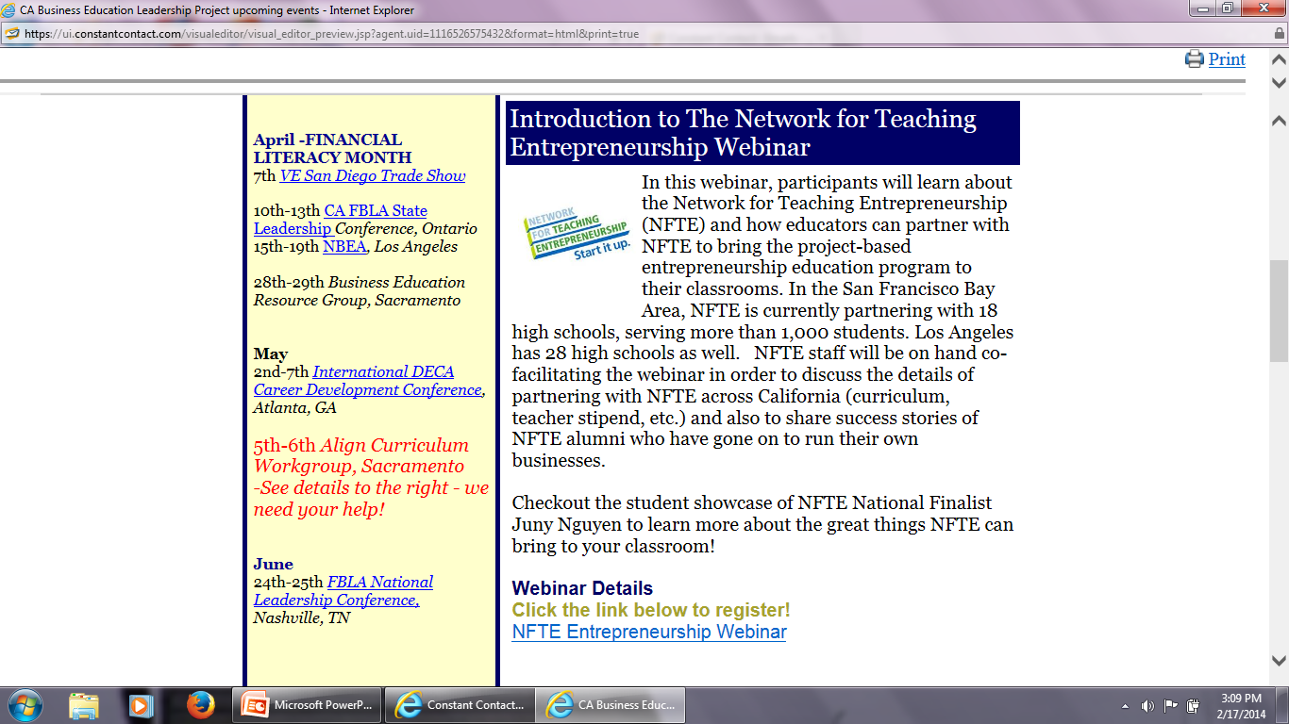
Notes:
I wanted to show you portions of the newsletter. This is the first webinar, last week. Another one is in the works. A shorter version of the NFTE webinar will be posted in the next newsletter.

Slide 11
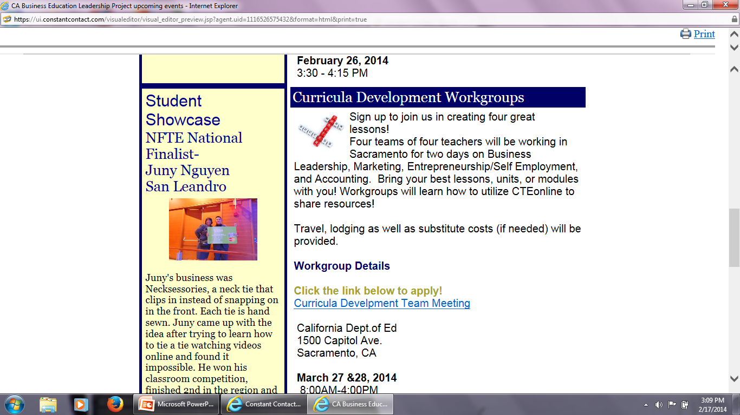
Notes:
Our first workgroup is at the end of this month in Sacramento. 16 teachers will look at four courses and develop units for:
Business Leadership
Accounting
Marketing
Entrepreneurship
I am going to be looking to you for some direction on these units later in the presentation.

Slide 12
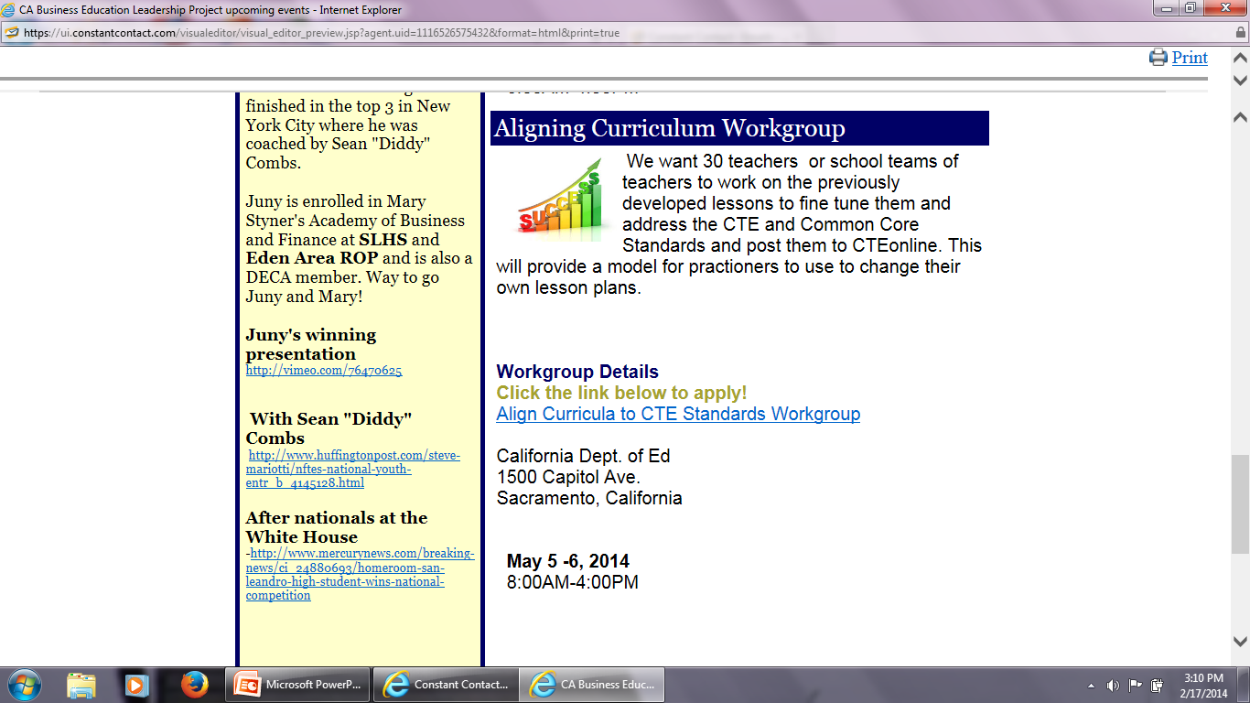
Notes:
Our next workgroup is May 5&6 where a larger group of teachers (even teams from a school) can come into work on previously developed lessons to fine tune them and address the new standards.

Slide 13
Notes:
Another important element of the newsletter is a student or program showcase. Showcased this time was Juny Nguyen from the Business Academy at San Leandro High School/ Eden Area ROP.. At the time of the competition, Juny was a sophomore! He is also a member of DECA.
His company is called Necksessories, he hand sews clip on tie (like a lanyard)
At the National NFTE competition, he was coached by Sean “Diddy” Combs
If you have a success story about your program or your students, I would love to hear from you!

Slide 14
Notes:
The last element that I would like to point out is the upcoming events section, located on the left side of the newsletter.

Slide 15

What is ahead
  Entrepreneurship/Self Employment for All
  Improve our contact list
  Continue partnership outreach
Notes:
Entrepreneurship/Self Employment for all is a big push right now. There are many organizations that can provide great products to help you in your classroom. We will be working hard to help across all industry sectors.
I want to continue to update the contact list.

Slide 16
Go To Your Corner!
Four Posters around the room
  Accounting
  Business Leadership
  Entrepreneurship
  Marketing
Select the corner that BEST fits your expertise
Designate a recorder & presenter
Brainstorm & record units/lessons that might be developed
  Identify & rank your top three ideas
Report out to the group for feedback
Notes:
15minutes to complete the activity, 10 -15 minutes to present them. Another 5-10 for the gallery walk.
Draw everyone to the this poster, have the presenter go over their ideas, ask others for any clarifying questions
Ask permission to share this information; tell them who I am sharing it with
Ask if anyone would like copies of this back?
Have a sign up sheet there if they are interested in taking part in a workgroup – just interested in finding out more about it. Not committing yourself to this. Would you be interested in being contacted about future participation

Slide 17
3-2-1
Three -Things you might need from me
Two - Questions that you need some clarification
One - Idea that you would like to share
Notes:
Three things you might need from me (do a sheet)
2 questions that need clarification
1 idea you would like to share about business education
USE SMART ART TO DEVELOP IT.

Slide 18

Questions?

Slide 19
Thank You for Coming!
Denise Gregor, Coordinator
530-745-1490
dgregor@placercoe.k12.ca.us
Notes:
One big take away I took from this session is X
One thing I will follow up with is this.

